Slide 1
Data Driven Car Following Models: KNN Wins the Battle, Random Forest will win War
Vineet Dhamija - 0774296
Neel Chaudhari - 0787894
Rakesh Singh - 0775942

Slide 2
Content
Motivation
Car Following Model Terminologies
Literature Review
Problem Statement
NGSIM Dataset
Data Cleaning
Data Transformation
Model Information
Results and Stats
Result
Future Scope
Application Demo

Slide 3

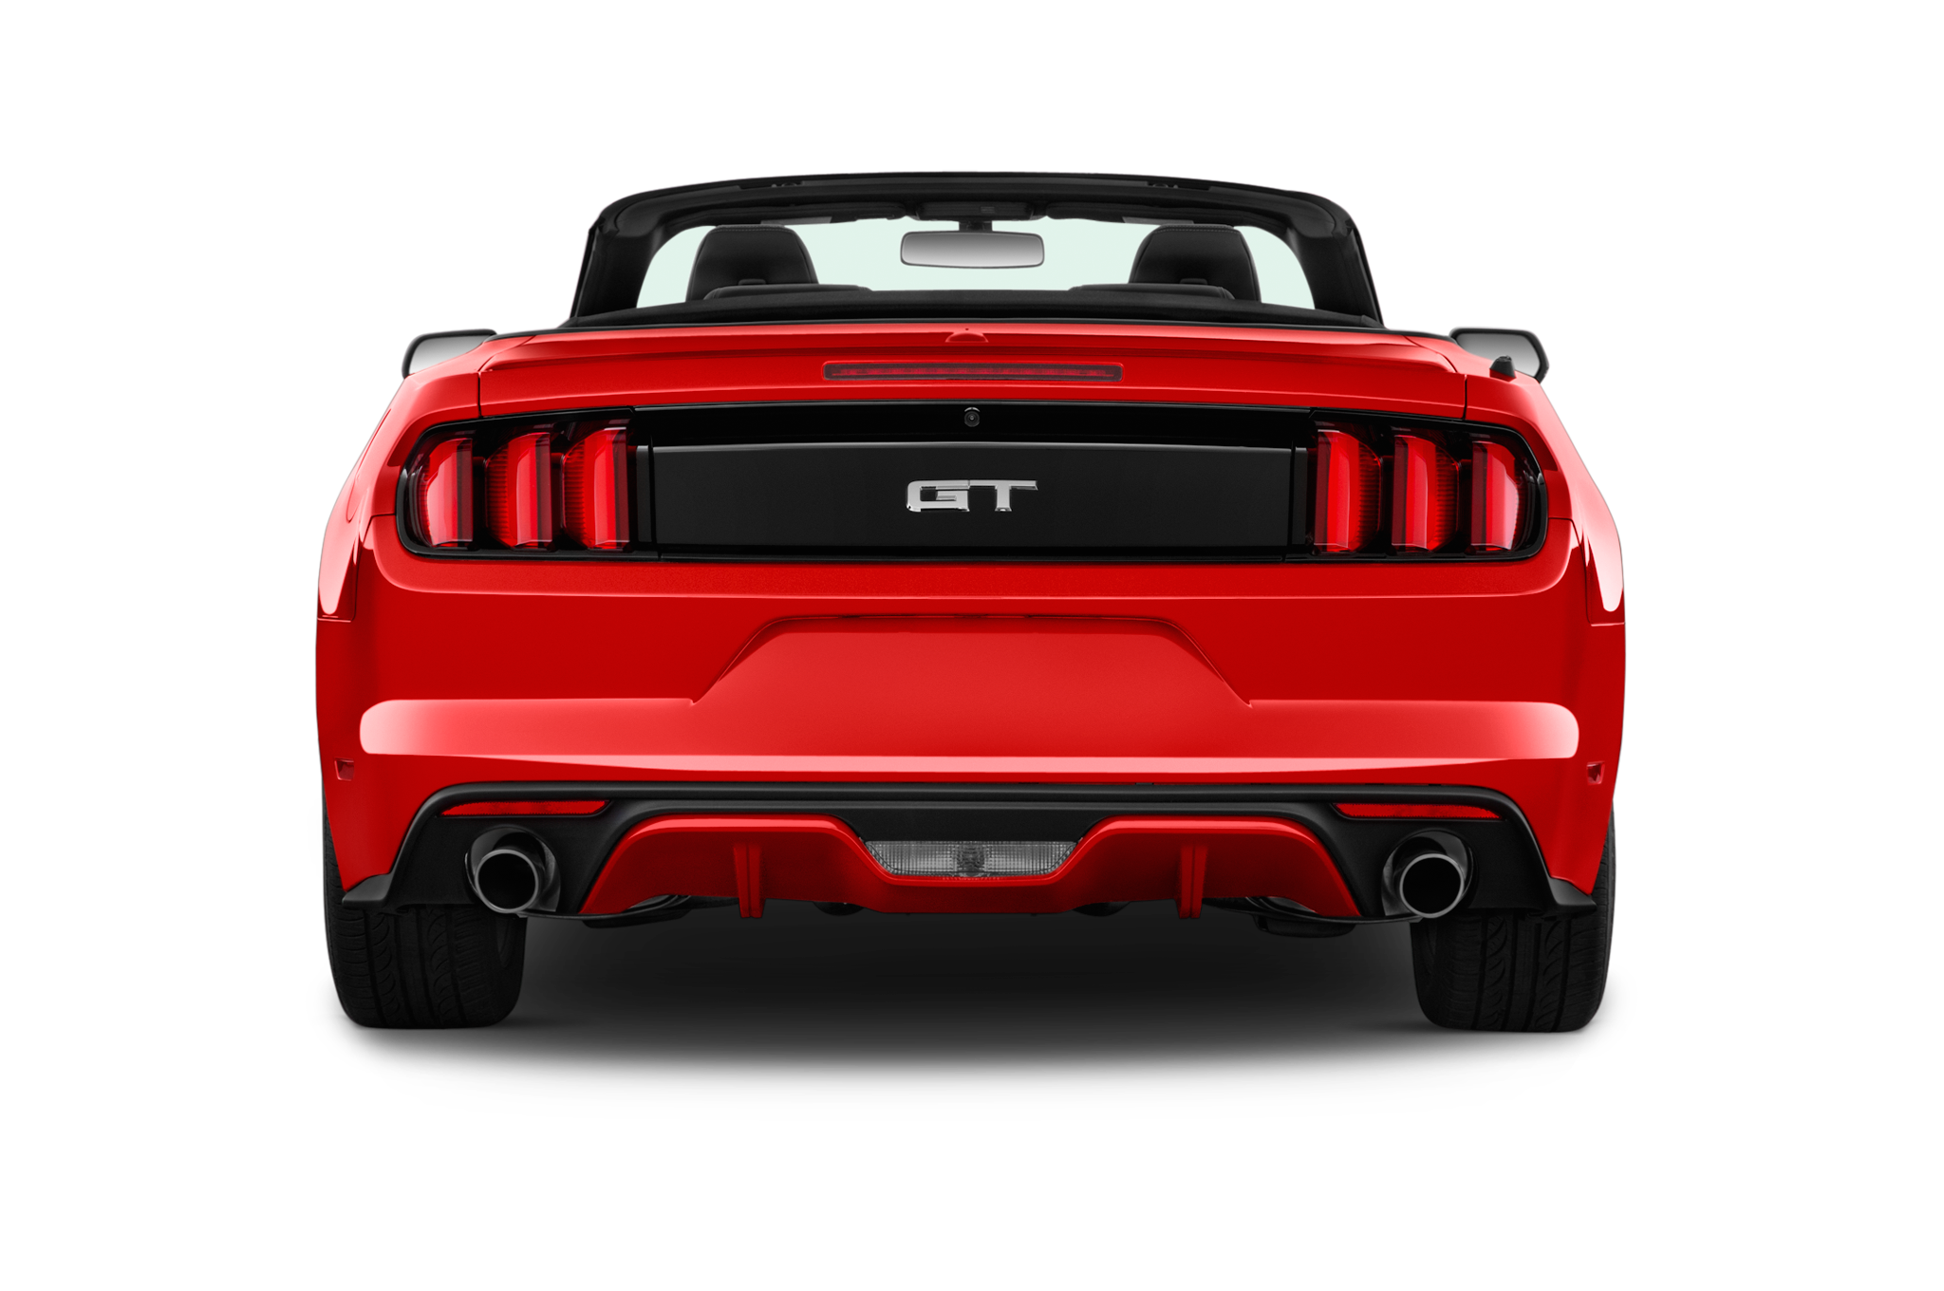
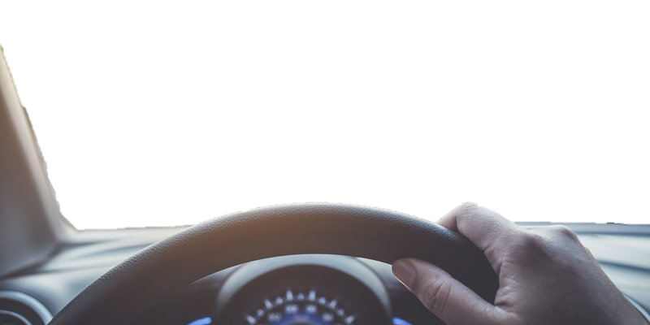
Lead
Free Driving:
Not Influenced by Lead Vehicle
Subject

Slide 4
Car Following:
Lead Vehicle Influences Acceleration, Deceleration(Braking), Velocity, Spacing and Jerk

Slide 5
Emergency Break
Lead vehicle too close
Avoid This, Have a Good Car Following Model

Slide 6

Car Following Model Terminology
Subject vehicle
Lead vehicle

Slide 7
Car Following Model Terminology
Space Headway
Vehicle Length
Subject vehicle
Lead vehicle

Slide 8
Car Following Model Terminology
Time Headway
Subject vehicle

Slide 9

Car Following Model Terminology
Space Headway
Vehicle Length
Subject vehicle
Lead vehicle
Space Headway
Front to Rear headway
Vehicle Length
Subject vehicle
Lead vehicle

Slide 10

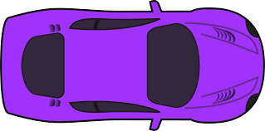
Literature Review
Mesoscopic
Microscopic
Macroscopic
Combination of Microscopic and Macroscopic
large group of traffic behavior analysis
Interaction of individual vehicle pair behavior analysis

Slide 11
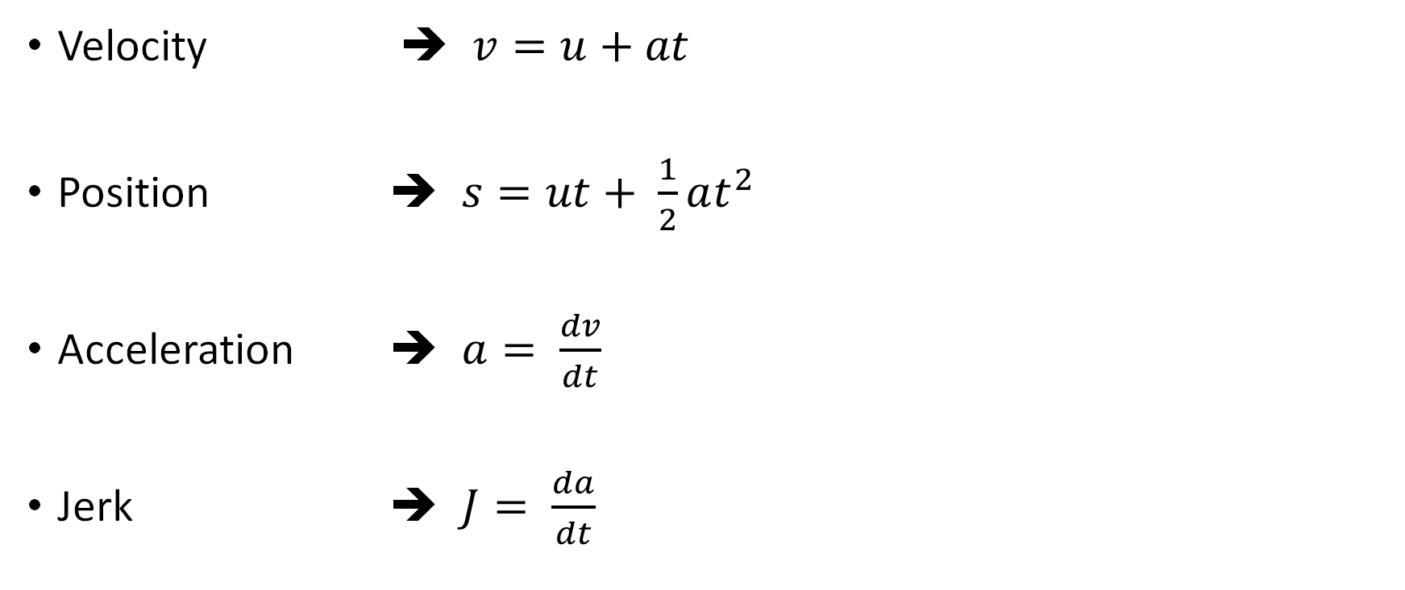
Literature Review
Velocity ➔ $v=u+at$
Position ➔ $s=ut+ \frac{1}{2}at^{2}$
Acceleration ➔ $a= \frac{dv}{dt}$
Jerk ➔ $J= \frac{da}{dt}$
u = initial velocity
v = final velocity
t = time
a = acceleration
s = distance
j = jerk
dv = change in velocity
dt = change in time
da = change in acceleration

Slide 12
Problem Statement
Problem:
Very few data driven models predict acceleration accurately.
Even with good RMSE scores, the trajectories do not match or aren’t displayed.
The papers either falsely claim good acceleration predictions or completely avoid mentioning it.
Proposed Solution
Create and compare Data Driven car following model using NGSIM dataset.
Display and compare trajectories along with R² and RMSE.

Slide 13

NGSIM Dataset
25
Columns
11.8M
Rows
Dataset Source
3
Vehicle Type
(Car, Motorcycle, Heavy Vehicle)
0.1
Preciseness
4
Locations

Slide 14
NGSIM Dataset
More than75%
Data on I-80 and US 101

Slide 15
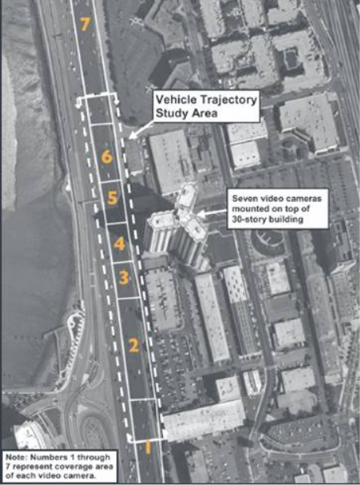
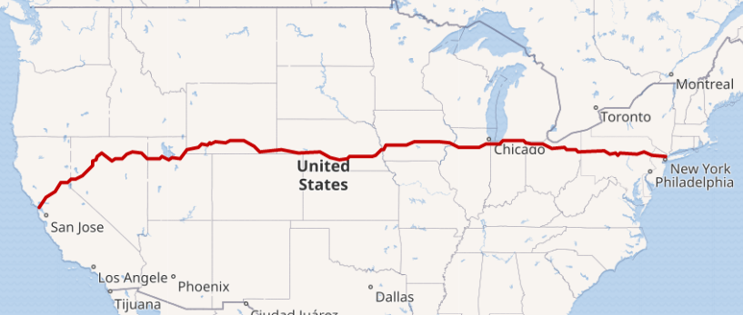
NGSIM Dataset
Interstate 80
45 Min Data
using 7 Cameras

Slide 16
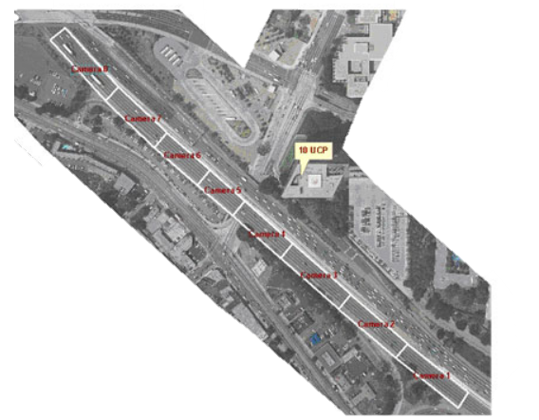
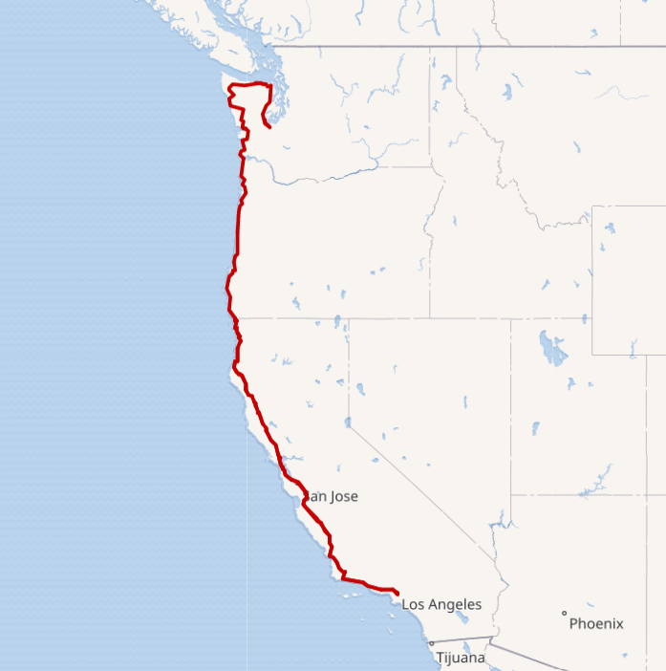
NGSIM Dataset
US 101
45 Min Data
using 8 Cameras

Slide 17
Data Cleaning
Lane 1, 2 & 3
Time Headway <= 10 sec
No
REMOVE
No
Yes
No
Trajectory during Overtake
Pair Duration >= 30sec

Slide 18
Data Transformation
Units Used: SI unit/Metric System
Space Headway: Front – to – Front ➔ Front – to – Rear
Front – to – Rear Headway
Subject vehicle
Lead vehicle

Slide 19
Model Information
Details of the model
Features | Lead Vehicle Rear to Subject Vehicle Front Space Headway, Lead Vehicle Class, Subject Vehicle Class , dv = Subject Vehicle Velocity – Lead Vehicle Velocity, Subject Vehicle Velocity
Target | Acceleration
Train /Validate/Test Split | 80/10/10
Random Forest | 30 Estimators
K-Nearest Neighbours | 5 N-Neighbours
Neural Network | Conv1D X 3 Blocks + Dense X 3 ; activators=tanh, sigmoid, elu

Slide 20
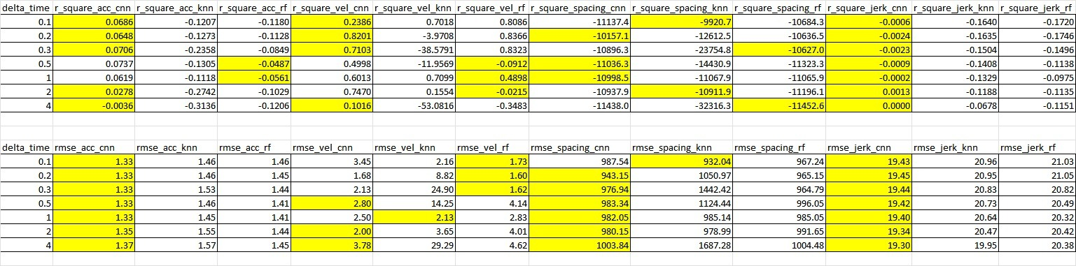
Results and Stats

Slide 21
Results and Stats
Model Name | Random Forest | KNN | CNN
Time to Fit | 150 s | 25 s | ~1 hr
Time to Preprocess and Predict 1 Pair | 31 s | 12 s | 68.2 s
Only Predict | 20 s | 2.4 s | 57 s
Time to Load Model | 3 s | 0.1 s | 0.4 s
Dataset division(train/Validate/test) in % | 83 /8 /9 | 83 /8 /9 | 83 /8 /9
Train/cal/Test Car Pairs Count | 4365 / 432 / 480 | 4365 / 432 / 480 | 4365 / 432 / 480
Time to Predict Test Pairs(per Reaction Time) | 40 Min | 12 Min | 161 min
Complete Test Set | 308 Min | 70 Min | 1291 Min
Size of Model on Disk | 3.5 GB | 100 MB | 558 KB
Above Results are based on execution in Local Machine with i7 processor and 48 GB Ram.
Recreation timings may vary.

Slide 22
Results
Random Forest with 150 Regressors had the best Trajectory.
KNN has the best results at hand with limited resources i.e. Local Machine.
CNN has best R2 and RMSE but bad trajectories and missed prediction scales.
All three models are able to meet the trajectory oscillations.

Slide 23
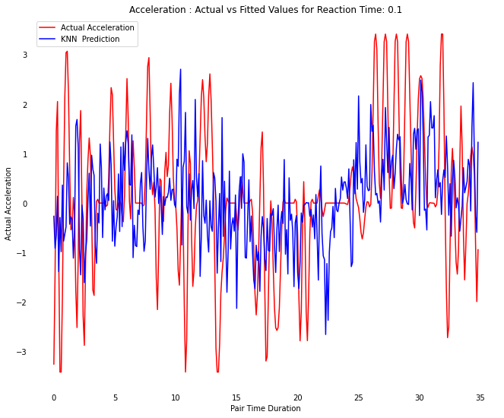
Result

Slide 24
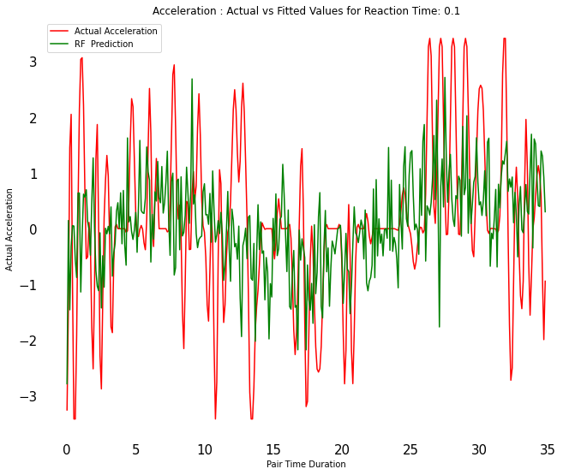
Result

Slide 25
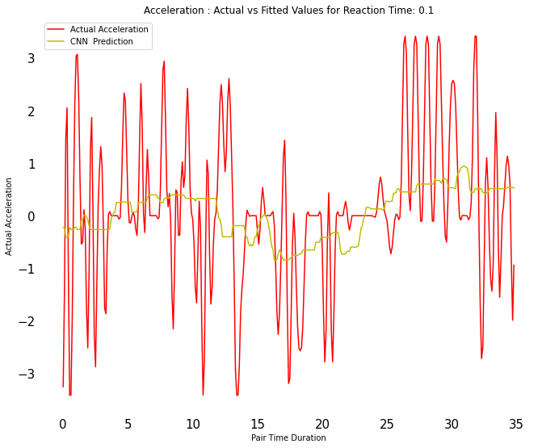
Result

Slide 26
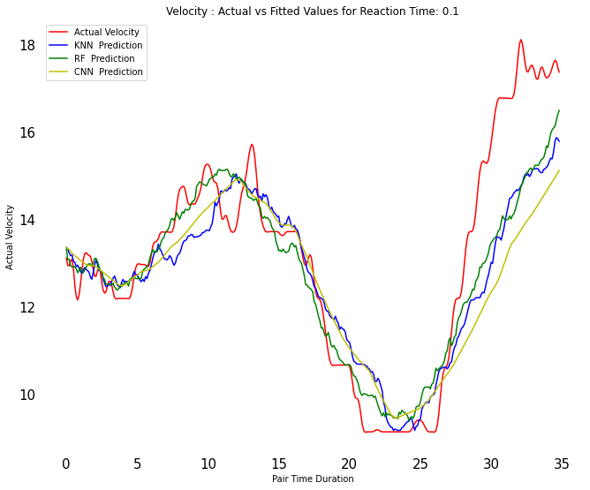
Result

Slide 27
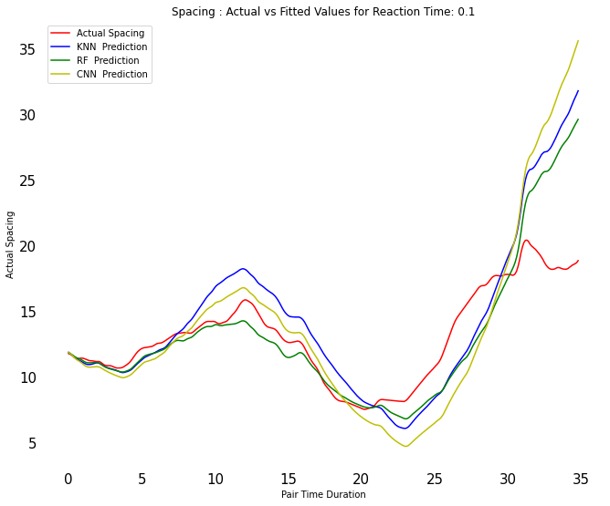
Result

Slide 28
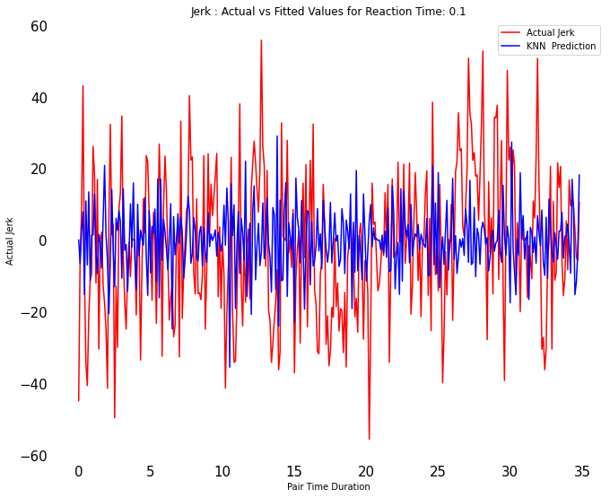
Result

Slide 29
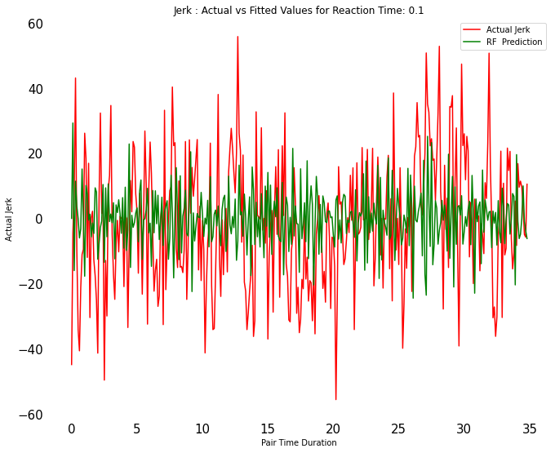
Result

Slide 30
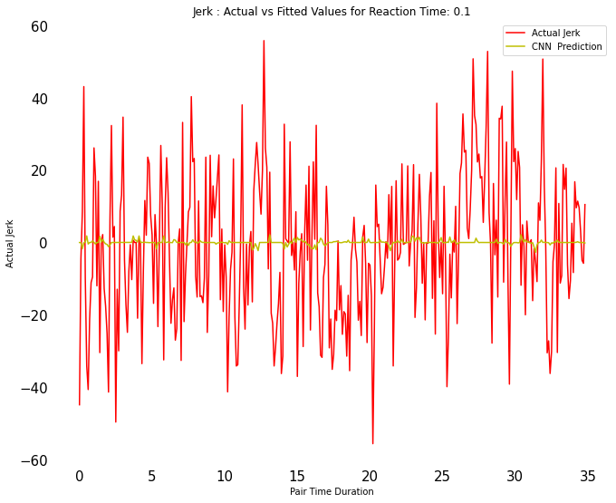
Result

Slide 31
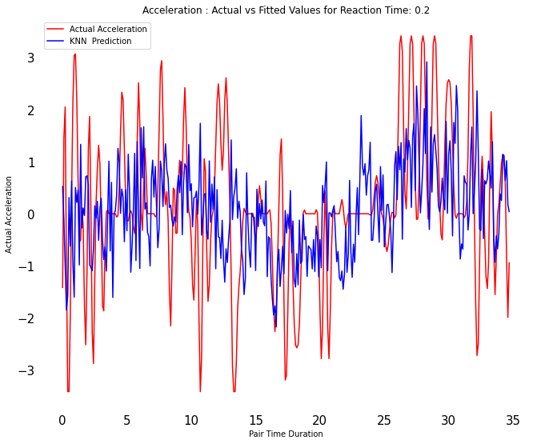
Result

Slide 32
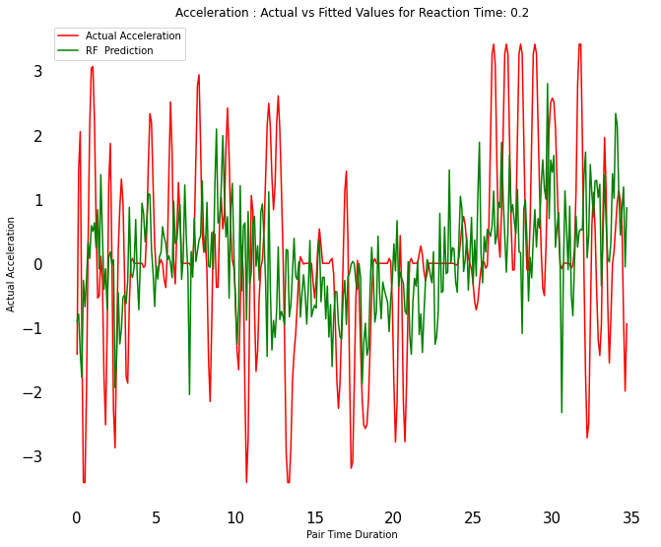
Result

Slide 33
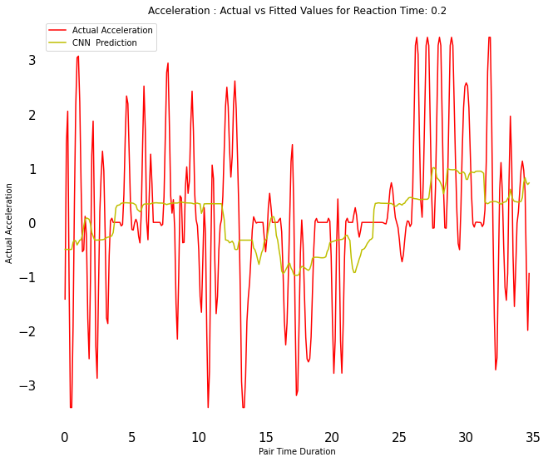
Result

Slide 34
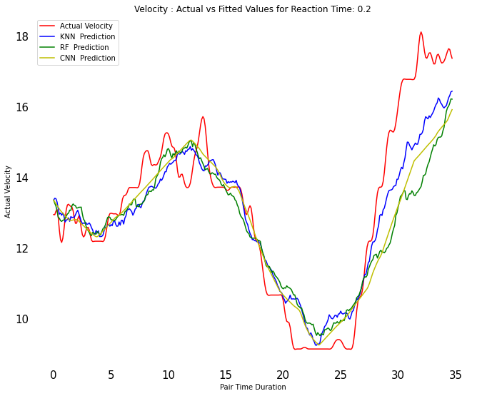
Result

Slide 35
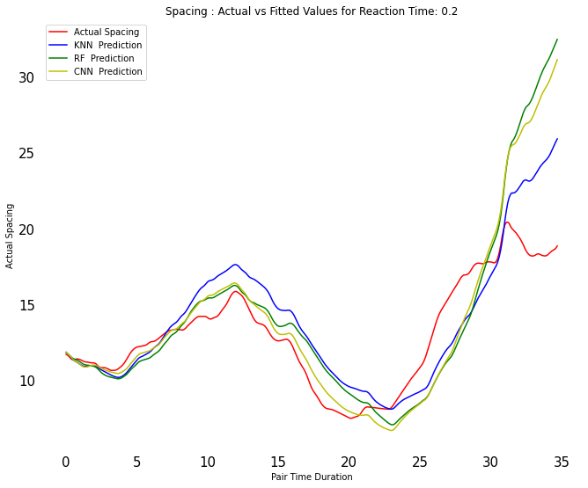
Result

Slide 36
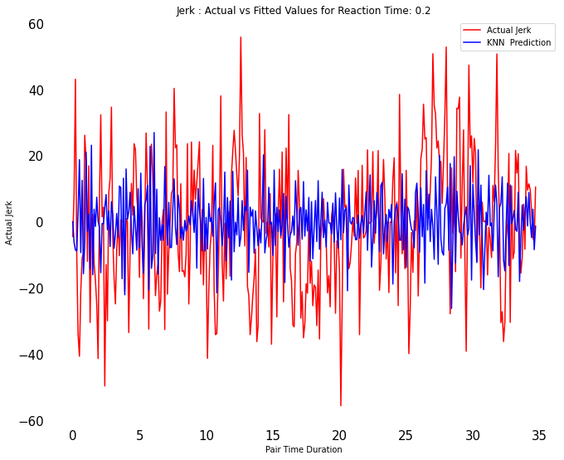
Result

Slide 37
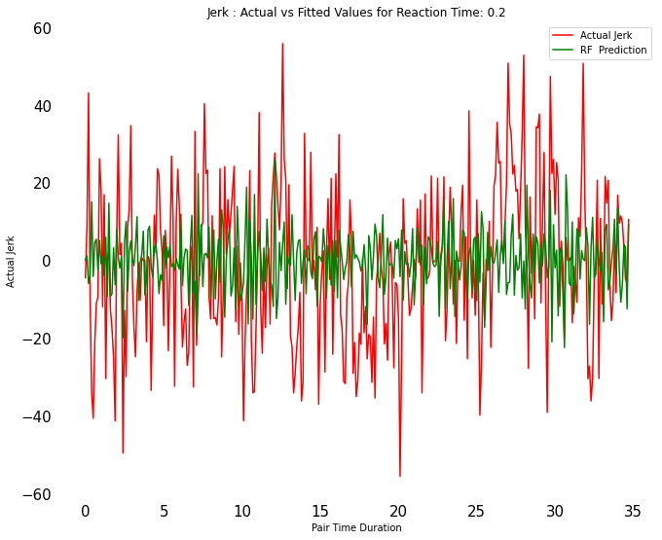
Result

Slide 38

Result

Slide 39
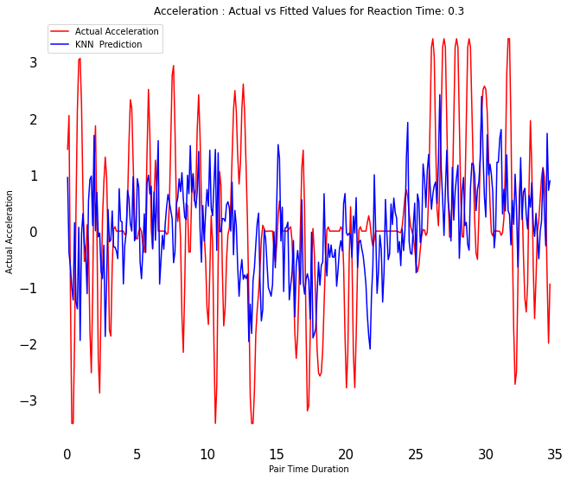
Result

Slide 40
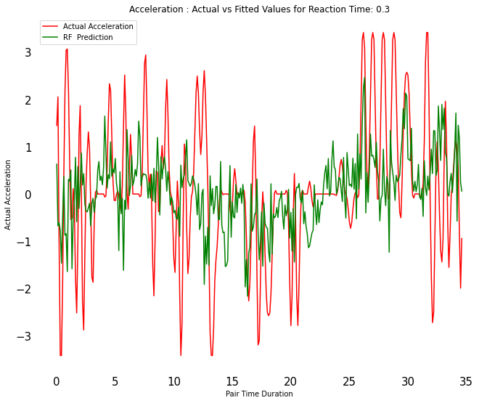
Result

Slide 41
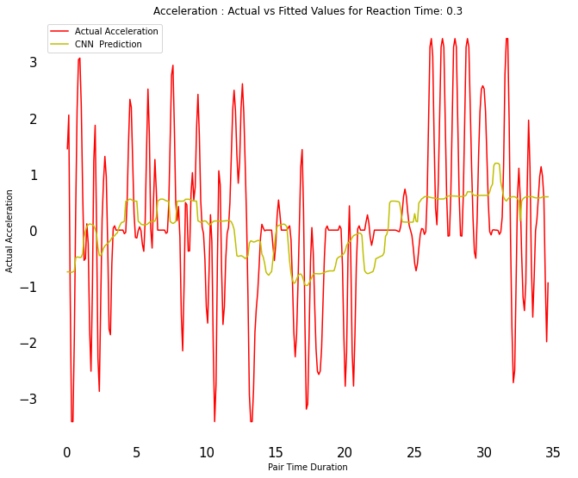
Result

Slide 42
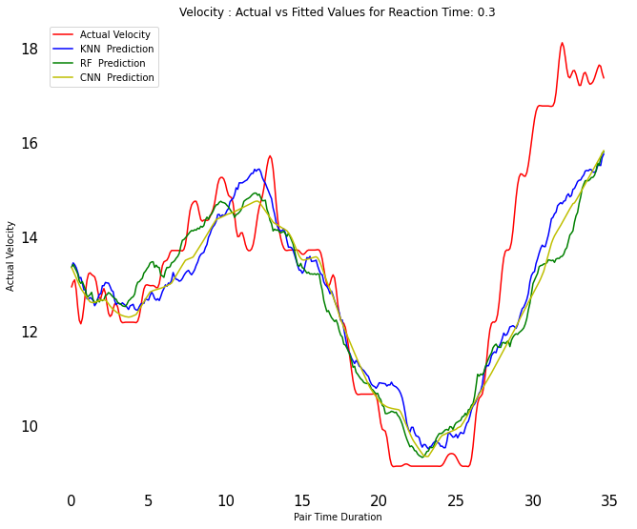
Result

Slide 43
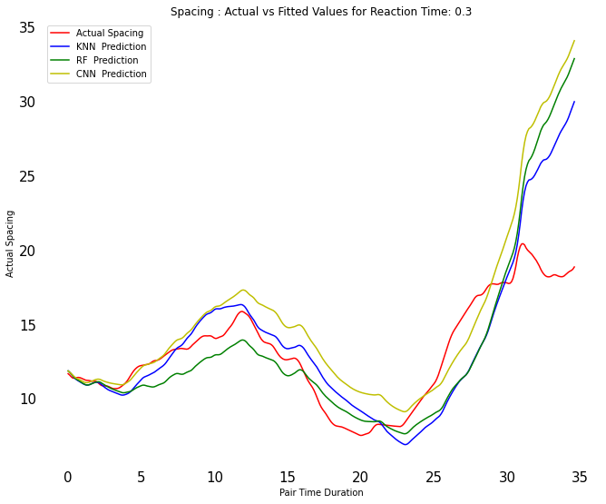
Result

Slide 44
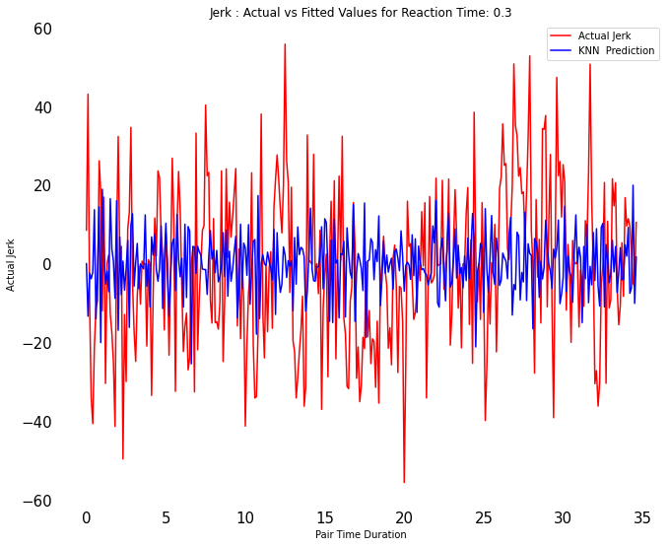
Result

Slide 45
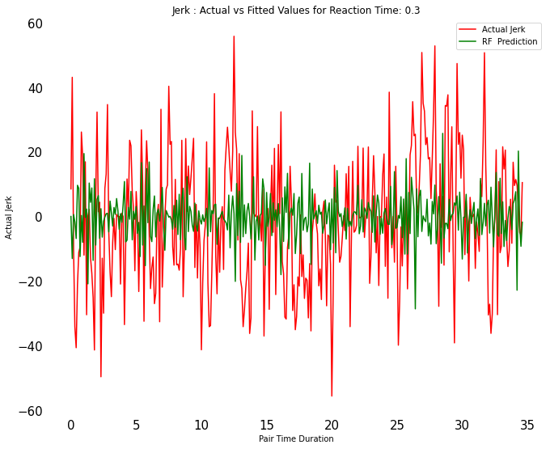
Result

Slide 46

Result

Slide 47
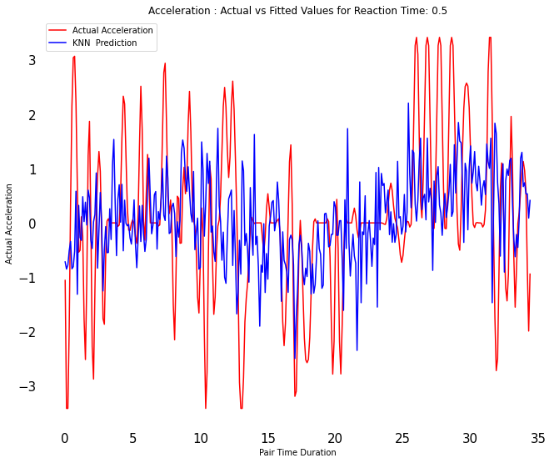
Result

Slide 48
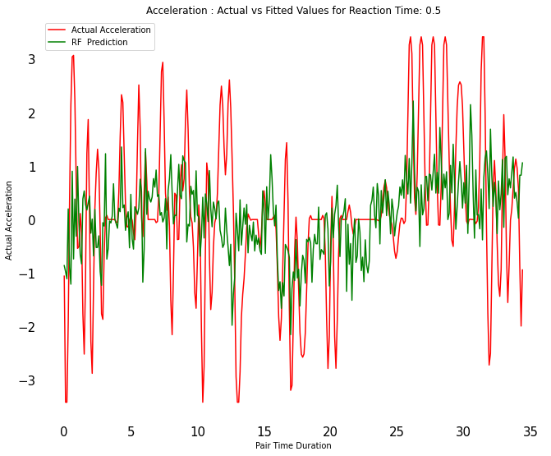
Result

Slide 49
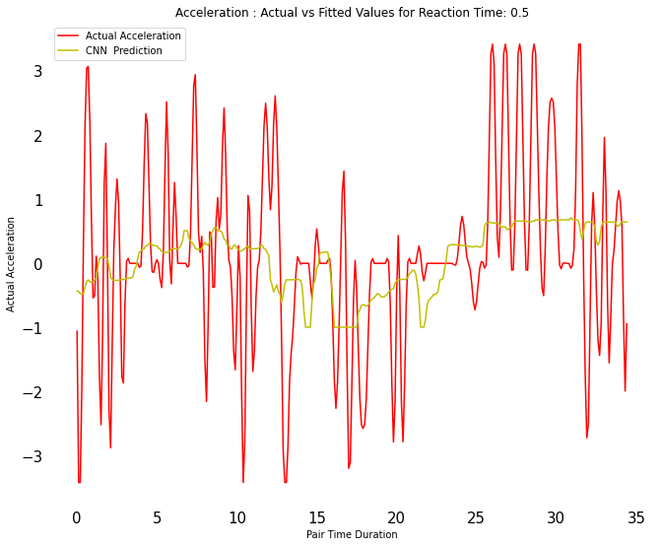
Result

Slide 50
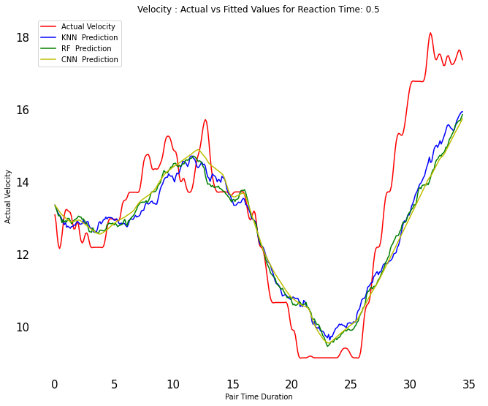
Result

Slide 51
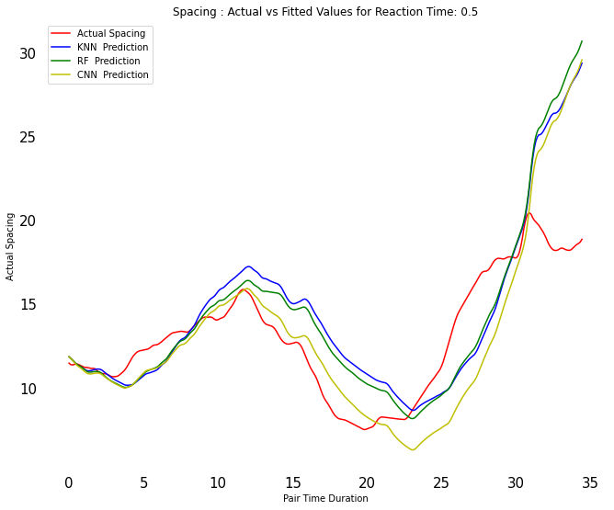
Result

Slide 52
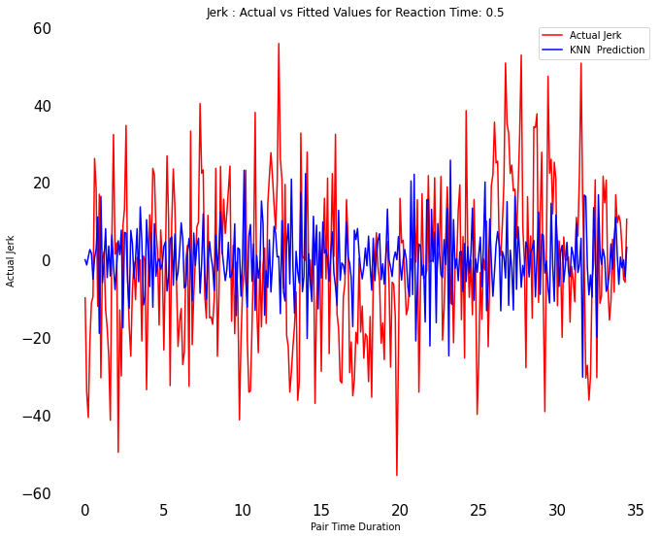
Result

Slide 53
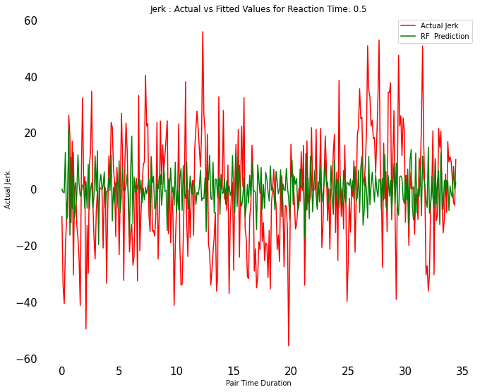
Result

Slide 54
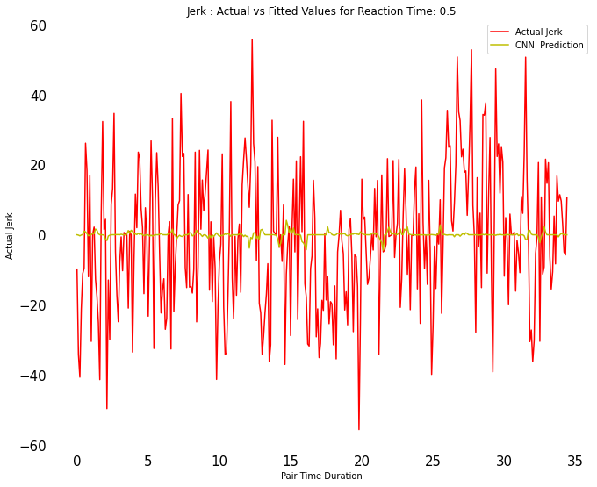
Result

Slide 55
Future Scope:
Create Prod App which predicts based on excel input.
Use Server and Docker to move past storage and CPU limitation.
Once on Docker update Random Forest from 30 to 150 Regressors.
Re-Train models on entire NGSIM data including Lankershim and Peach tree.
Use Dynamic Time Warping to verify Accuracy.

Slide 56
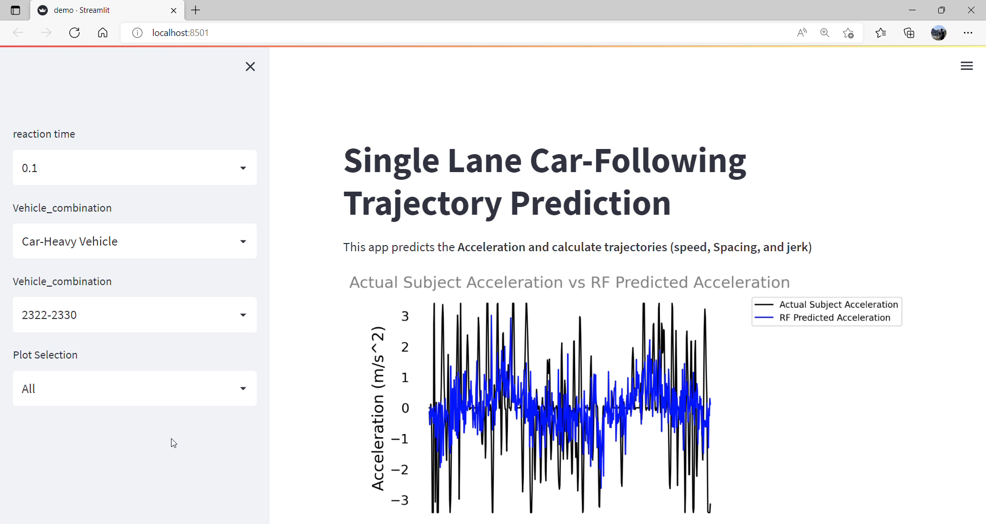

Slide 57

Queries

